Slide 1
AWS Workspace Protection

Slide 2






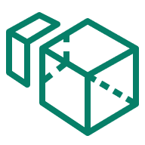
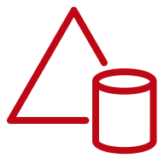
The same VPC security control
AWS Cloud
Availability Zone
Virtual private cloud (VPC)
Internet gateway
Public subnet
Private subnet
Amazon WorkSpaces
Amazon WorkSpaces
Simple AD

Slide 3
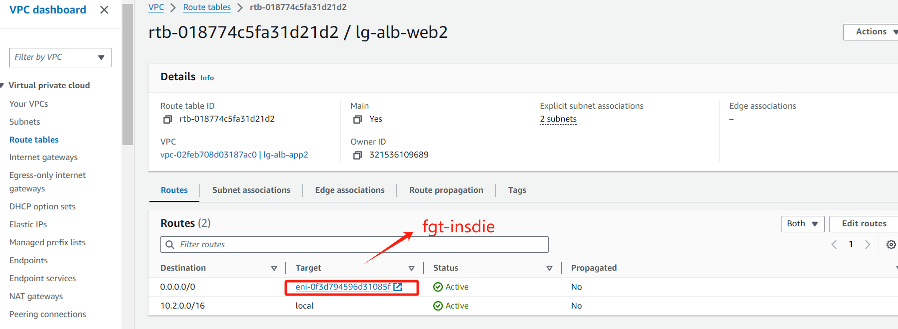
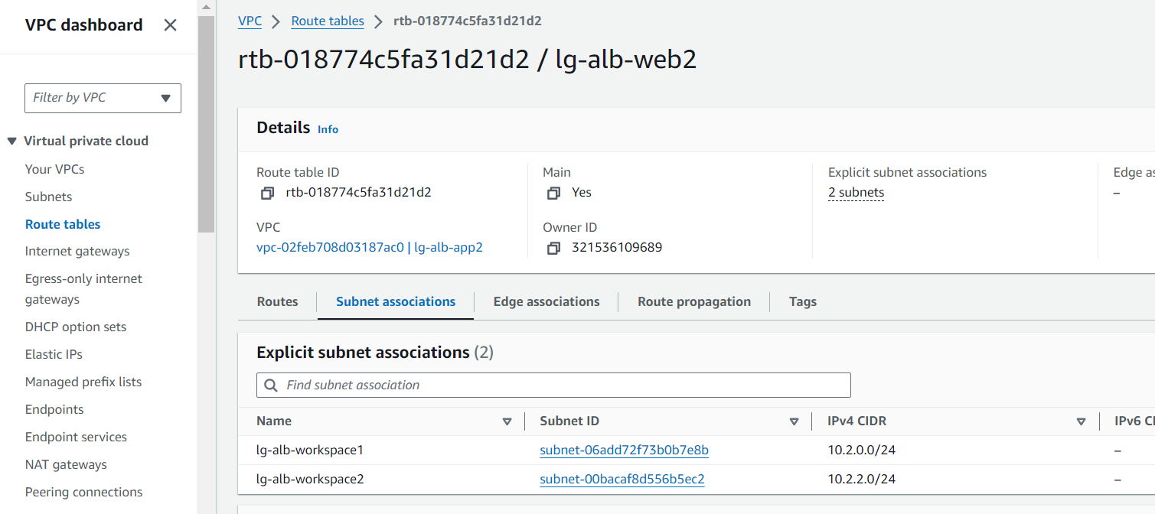
Workspace rtb

Slide 4
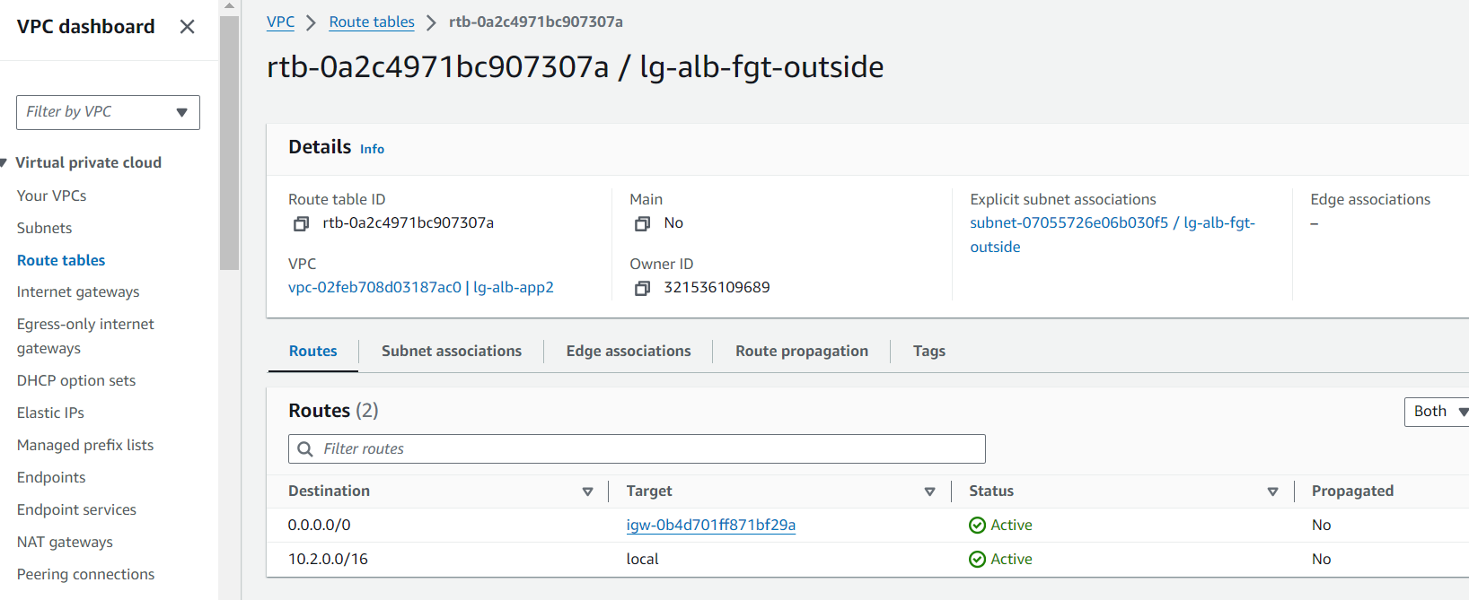
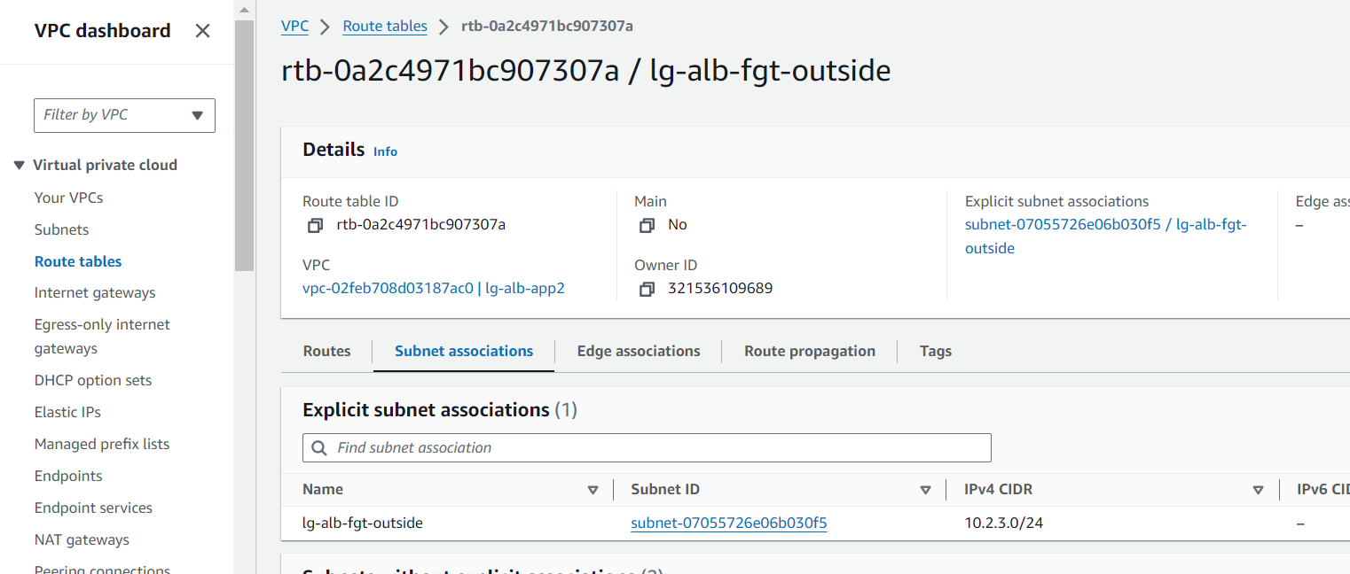
Fgt rtb

Slide 5
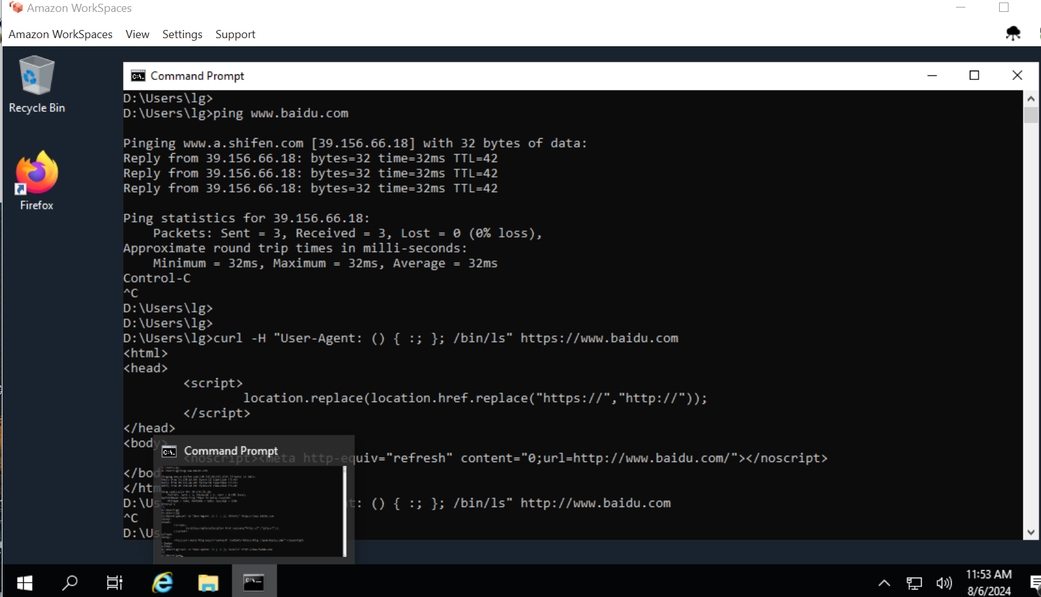
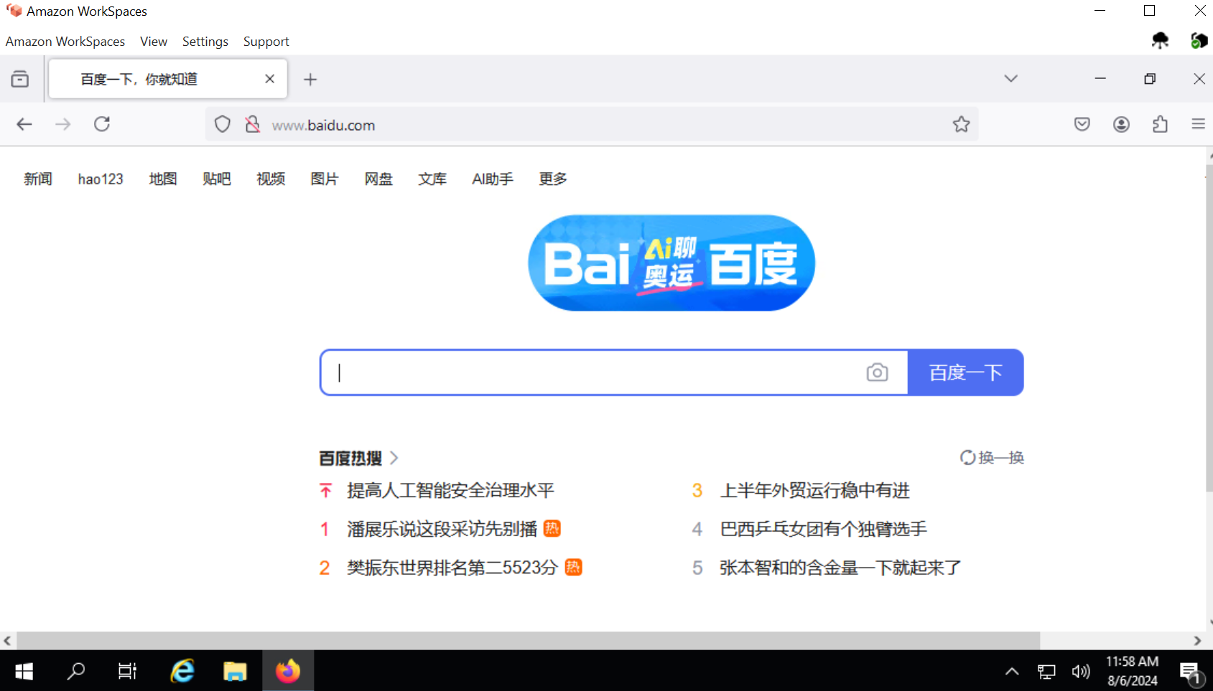
Test-1

Slide 6
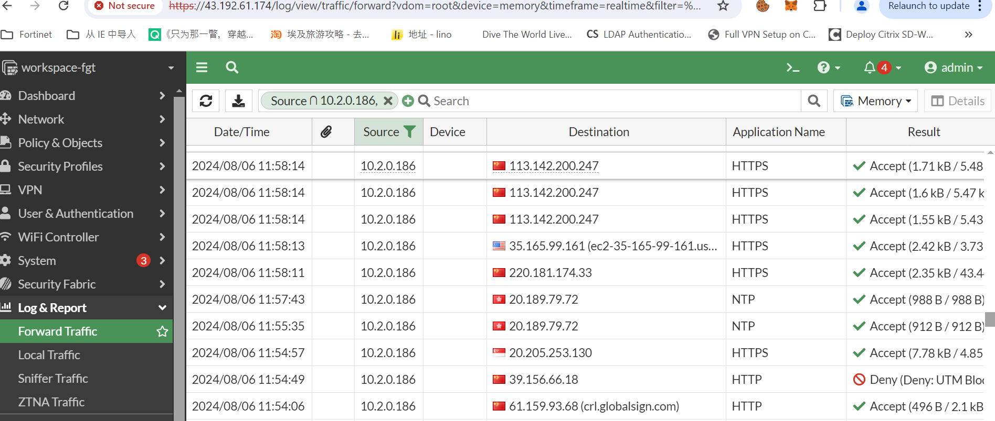
Test-2

Slide 7


The Cross VPC security control
AWS Cloud
Virtual private cloud (VPC)
Virtual private cloud (VPC)
Public subnet
Private subnet
Internet gateway
Internet gateway
Private-link
Amazon WorkSpaces
Amazon WorkSpaces
Simple AD
Endpoints
Private subnet
Gateway Load Balancer

Slide 8
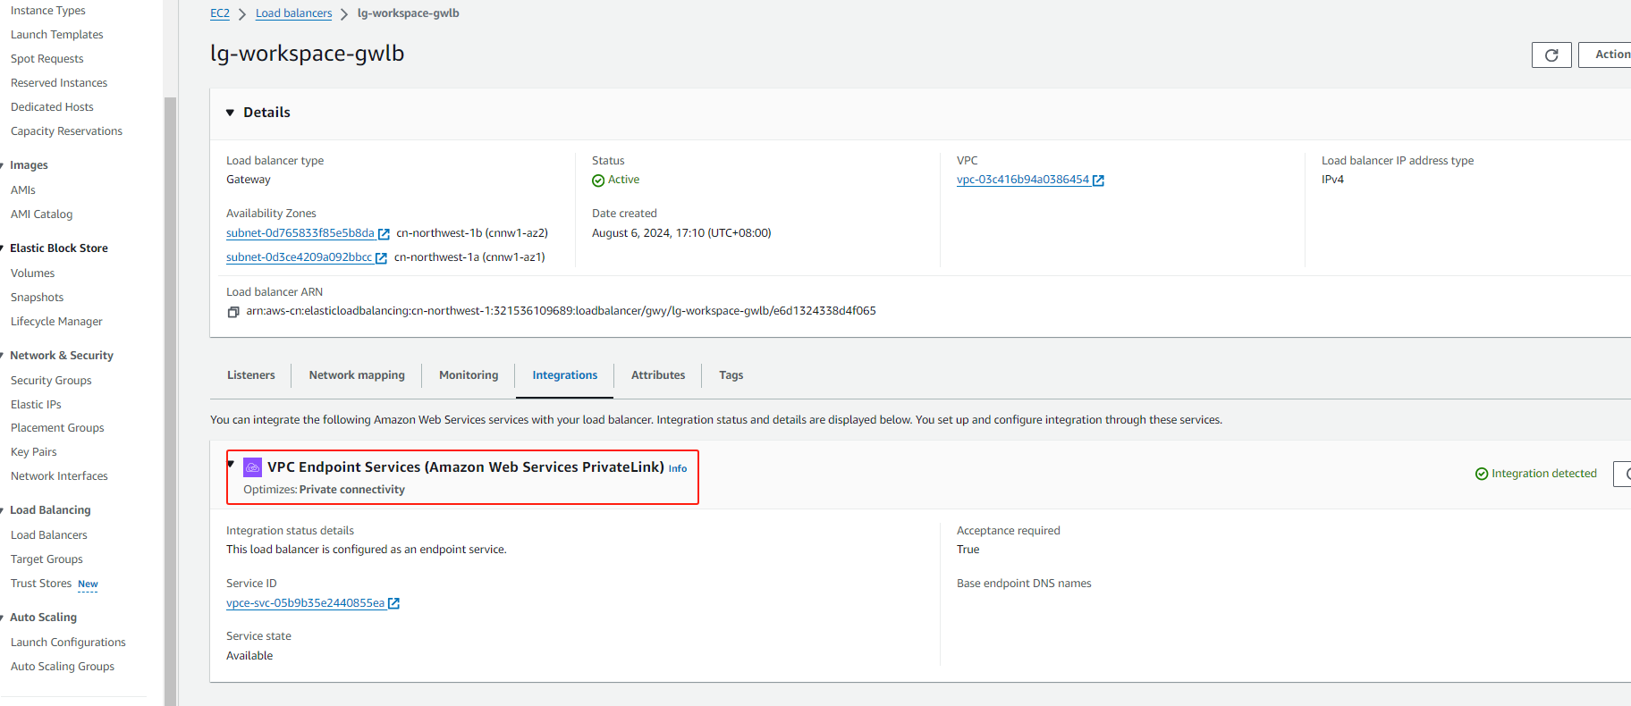
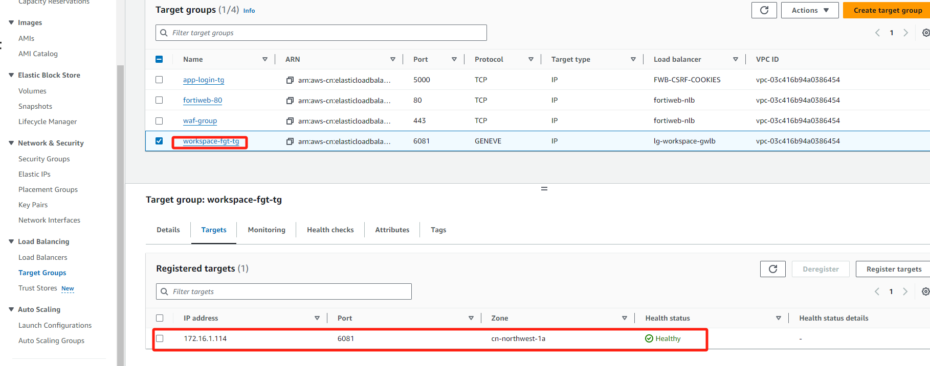
Gwlb config

Slide 9
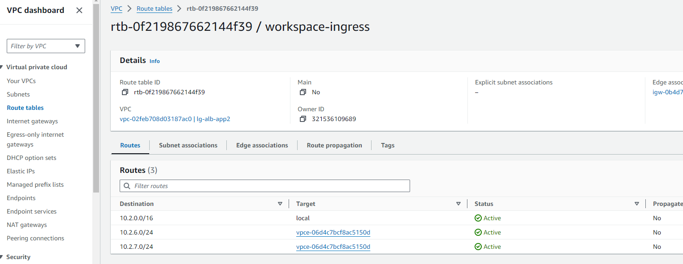
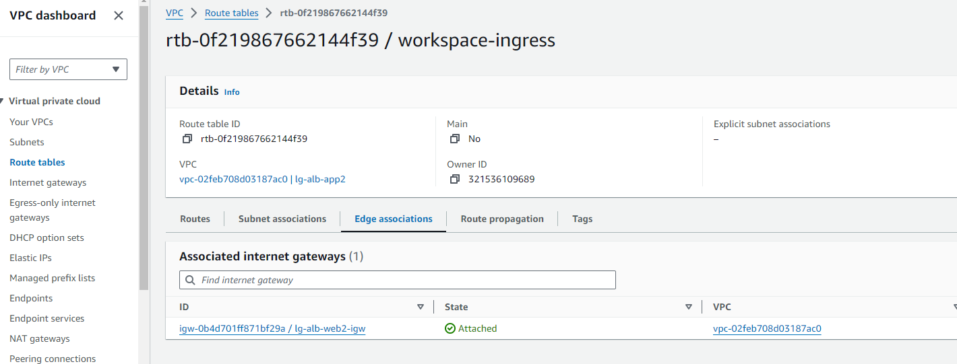
ingress-rtb

Slide 10
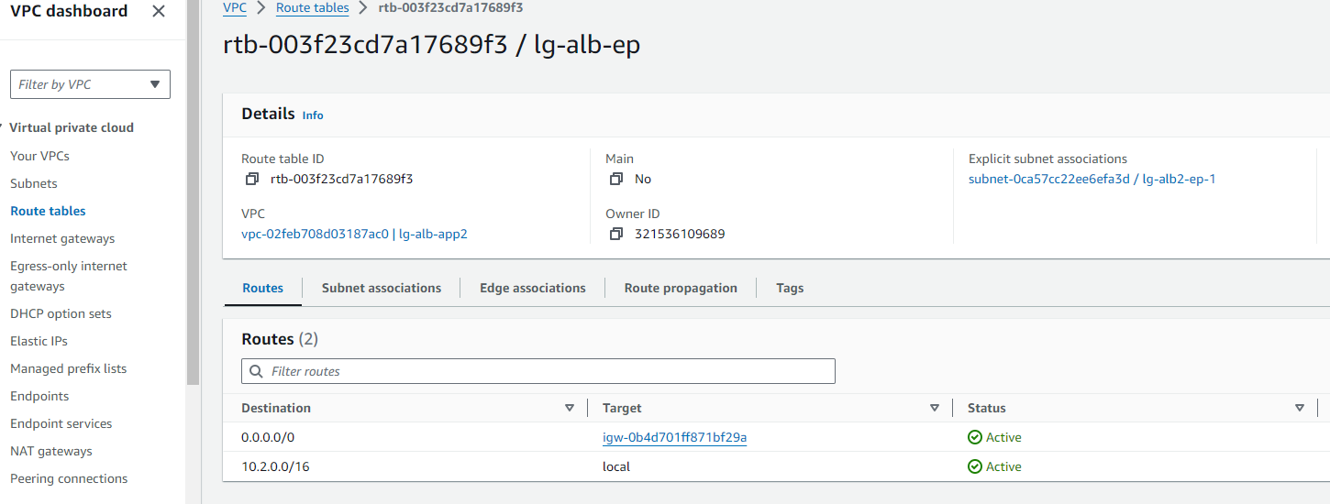
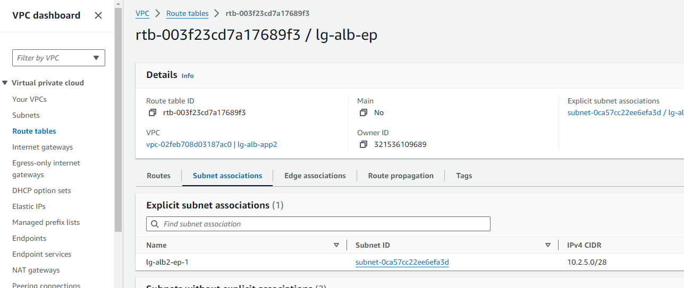
Gwlbe-rtb

Slide 11
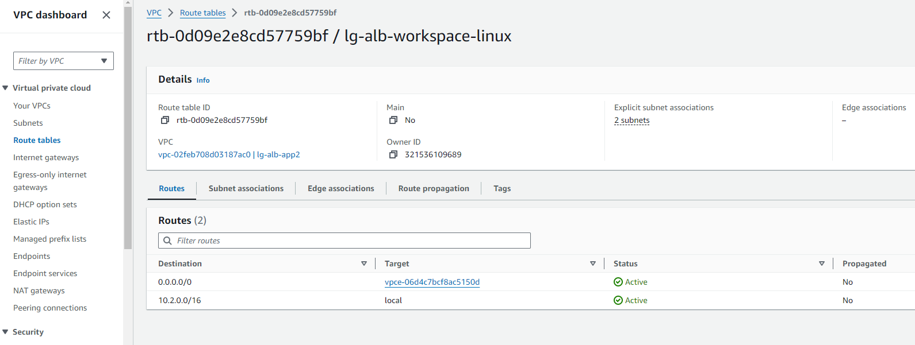
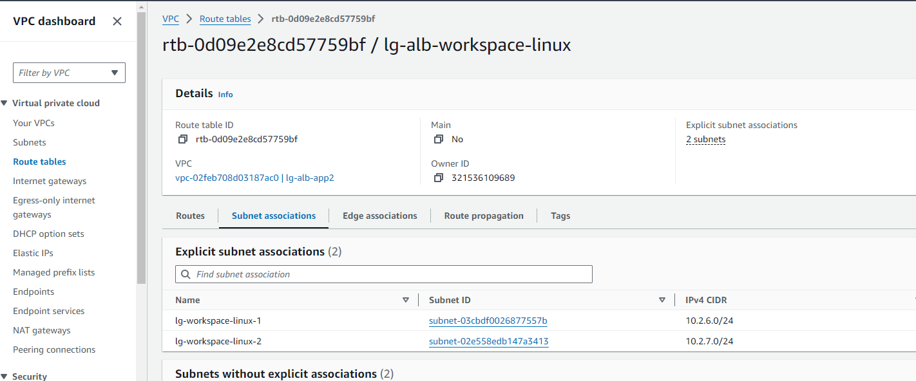
Workspace(linux)-rtb

Slide 12
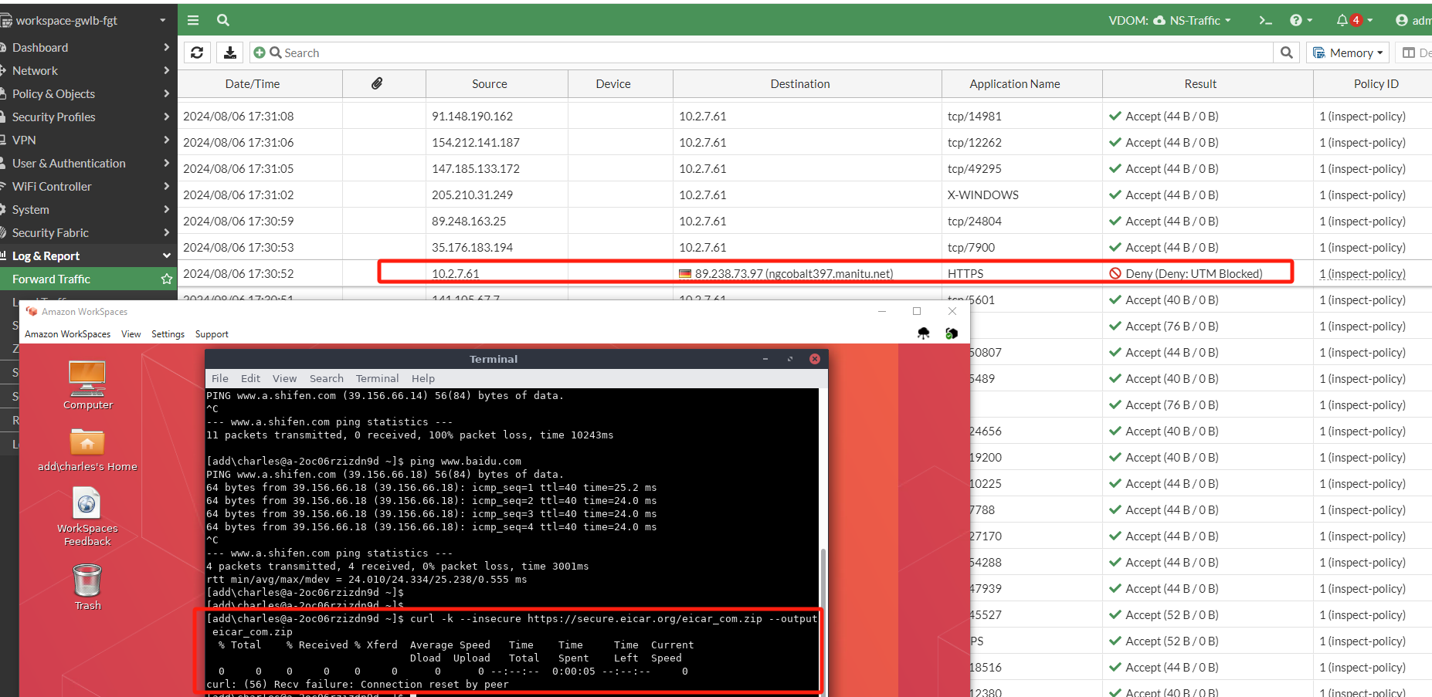
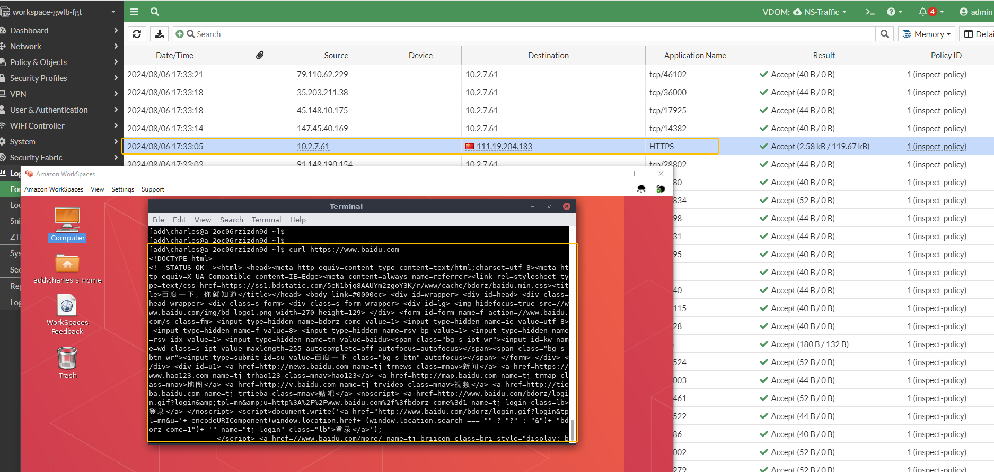
Test-1

Slide 13


The Cross VPC security control
AWS Cloud
Virtual private cloud (VPC)
Virtual private cloud (VPC)
Public subnet
Private subnet
Internet gateway
Amazon WorkSpaces
Amazon WorkSpaces
Simple AD
attach
tgw
attach
Private subnet

Slide 14
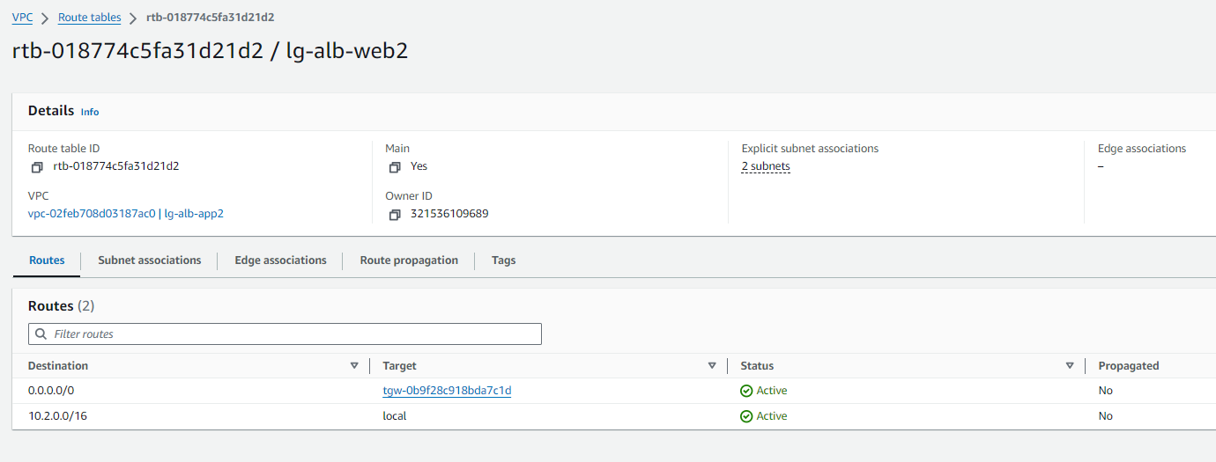
workspace rtb-1

Slide 15
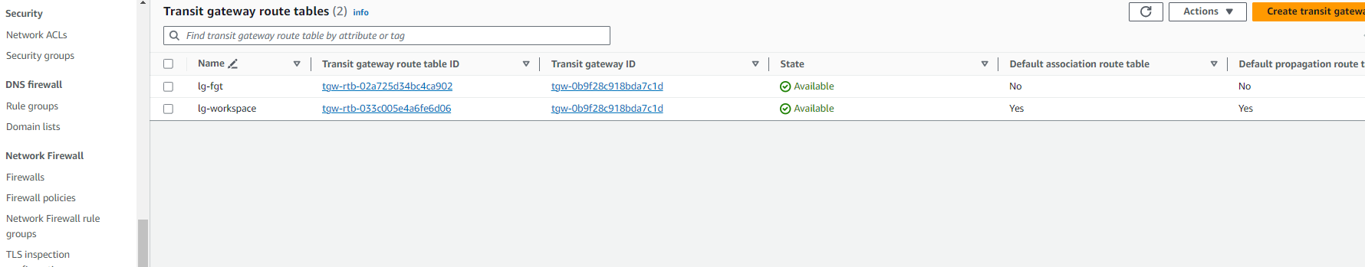
Tgw rtb-1

Slide 16
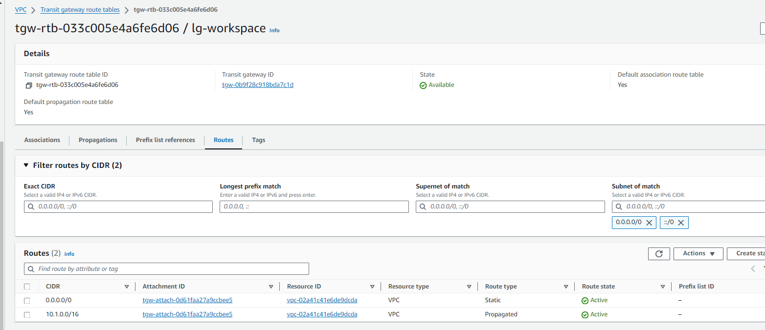
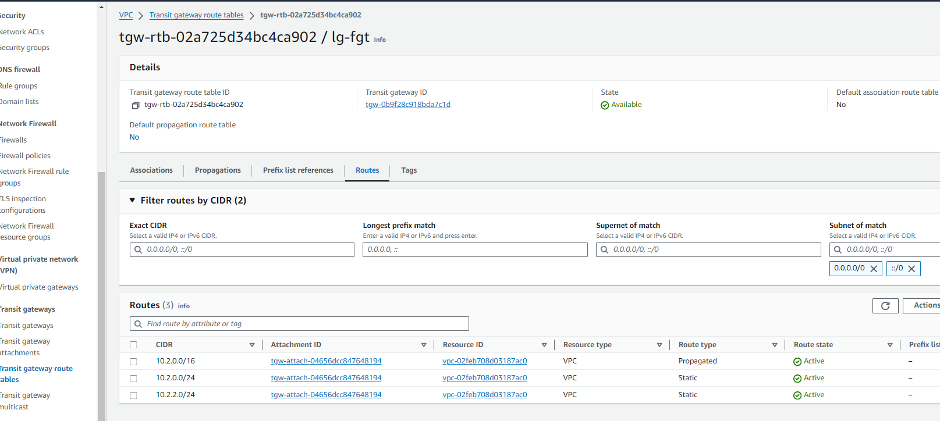
Tgw rtb-2

Slide 17
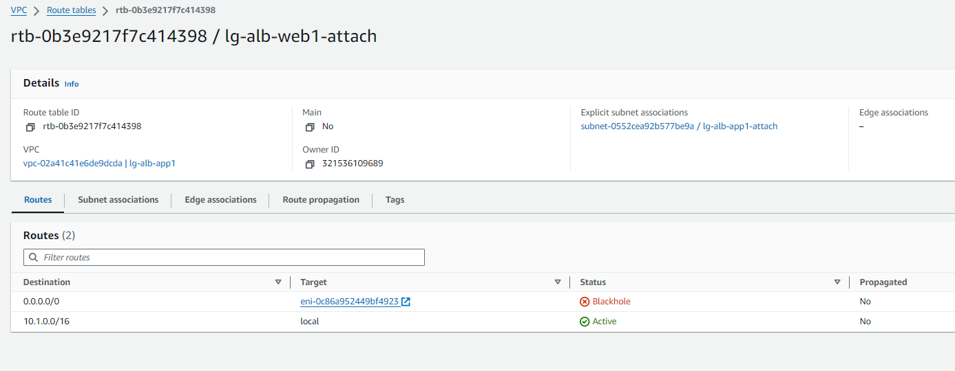
Fgt attach rtb
防火墙关机了所以status blackhole

Slide 18
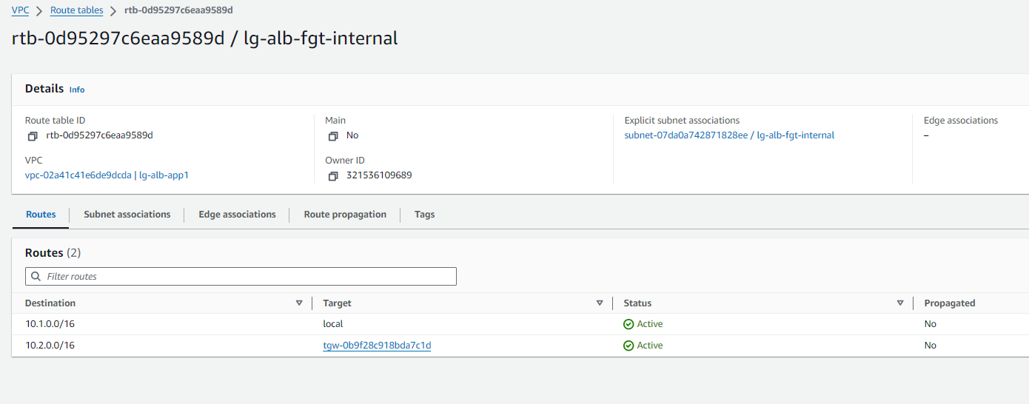
Fgt inside rtb

Slide 19
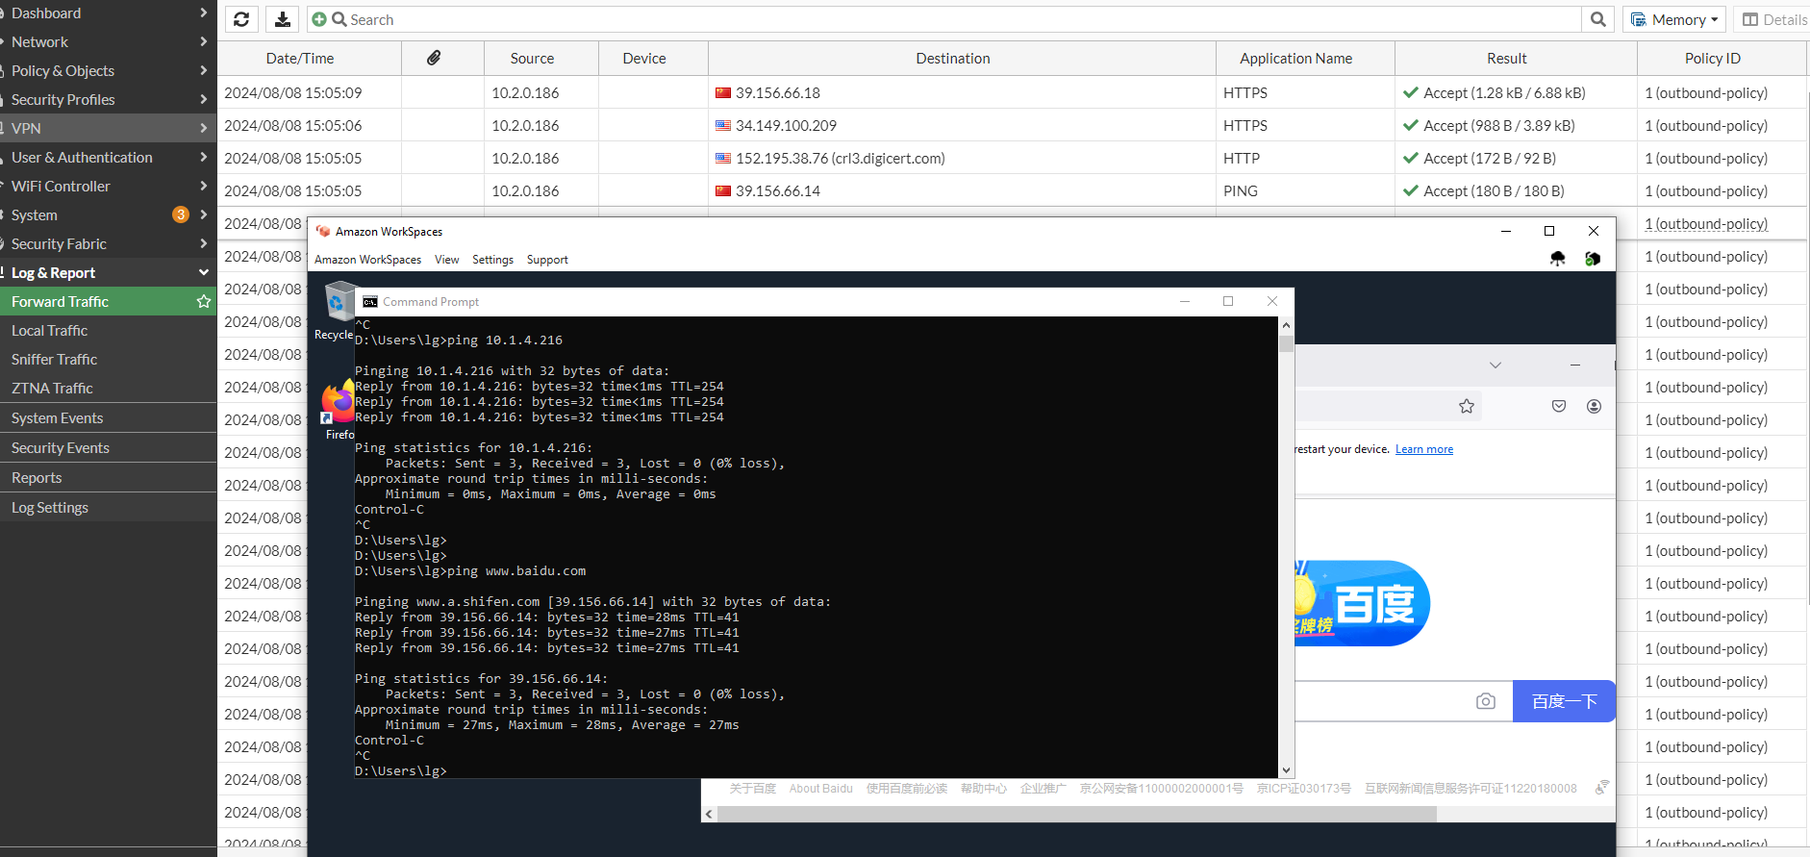
Test-1

Slide 20
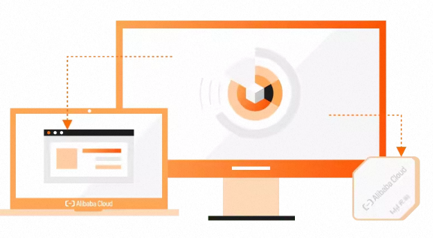
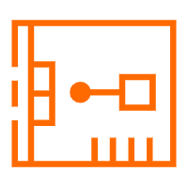


Ali workspace with cen-tr security inspection
无影VPC
VSwitch
VSwitch
attachment
VSwitch
Sec-vpc
云企业网
CEN-TR
TR
attachment
VSwitch
FortiGate NGFW
Internet

Slide 21
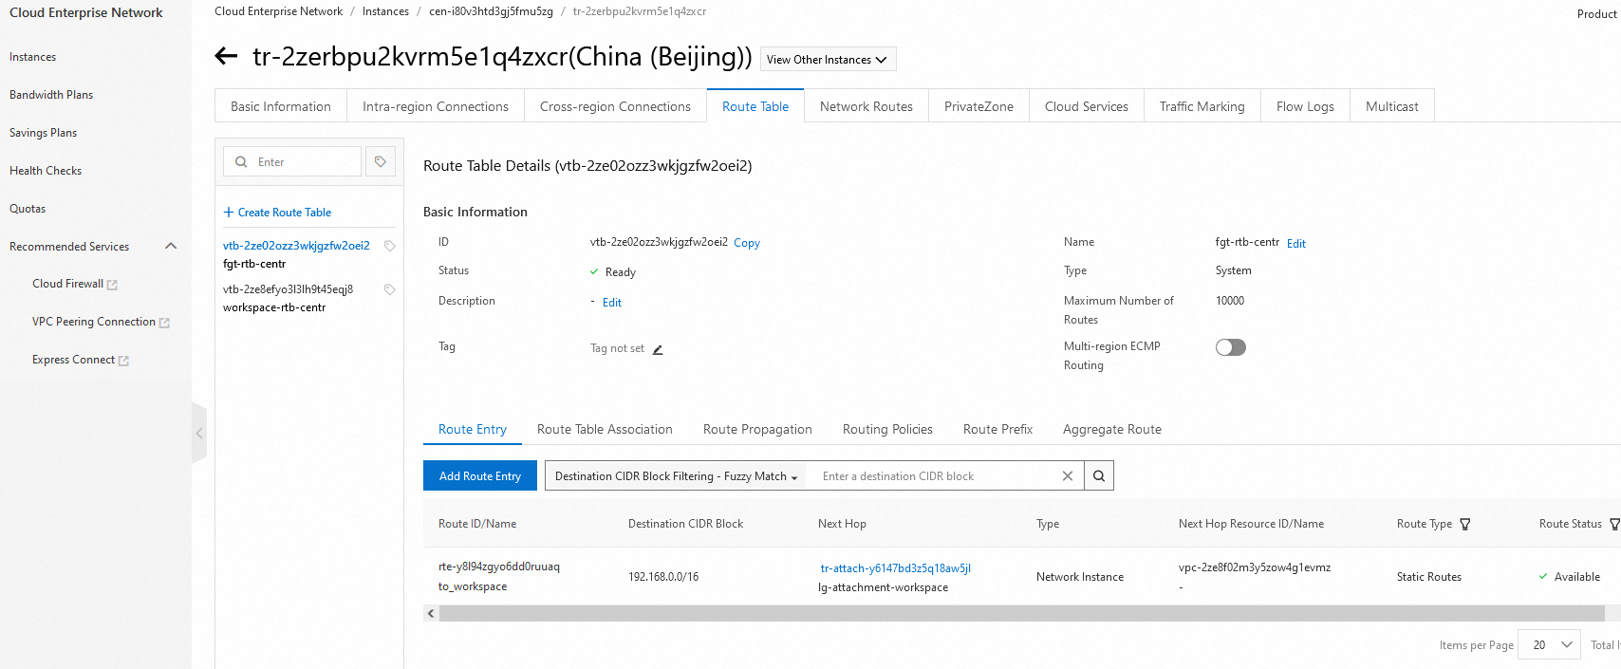
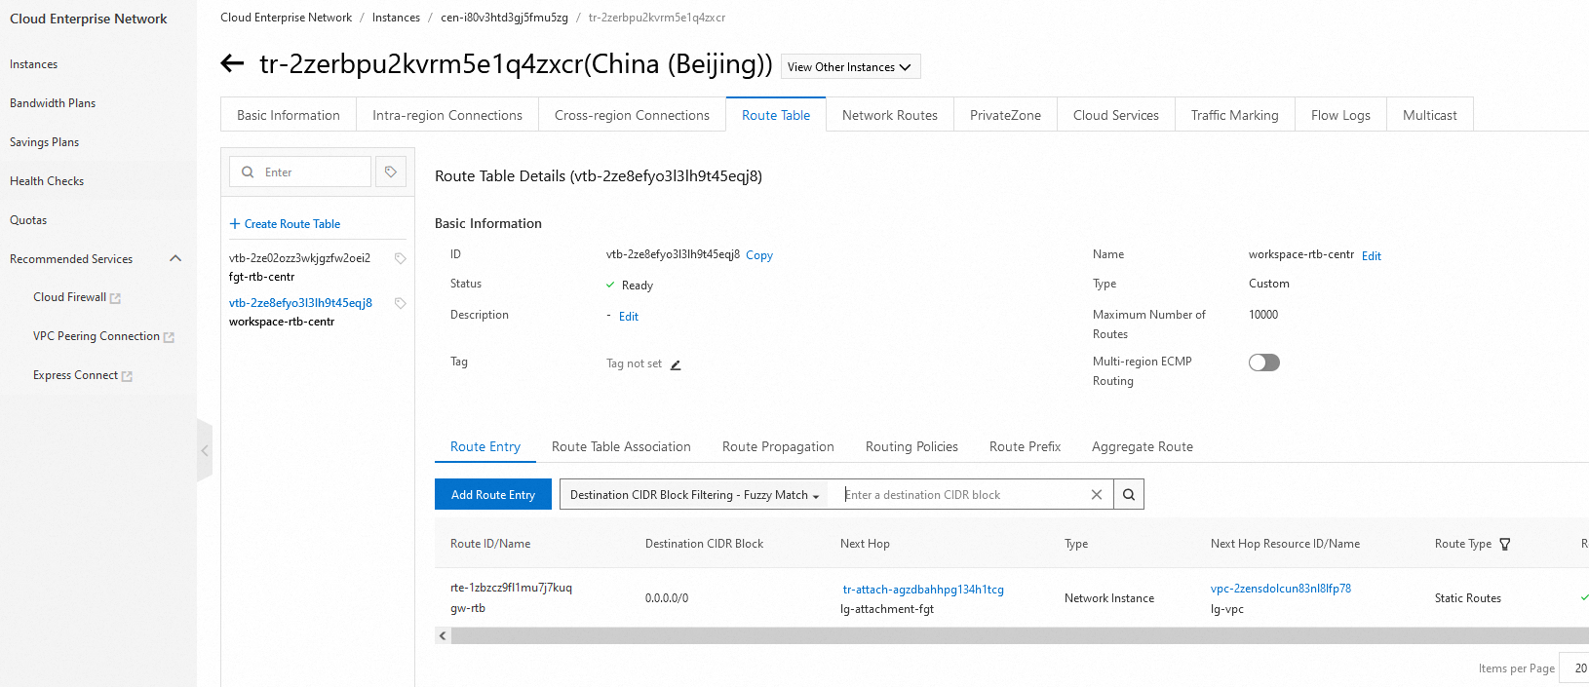
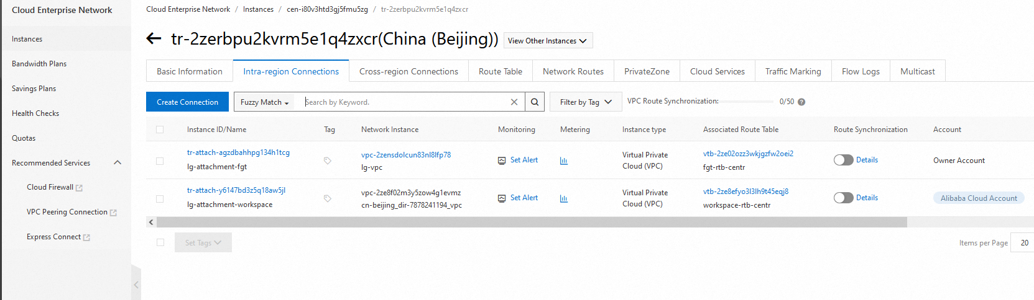
CEN-TR

Slide 22
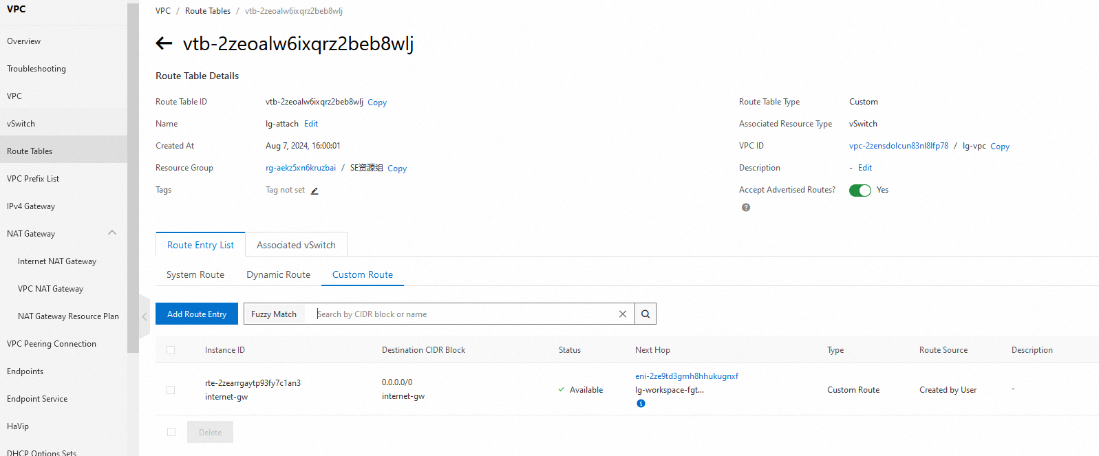
FGT-attach-RTB

Slide 23
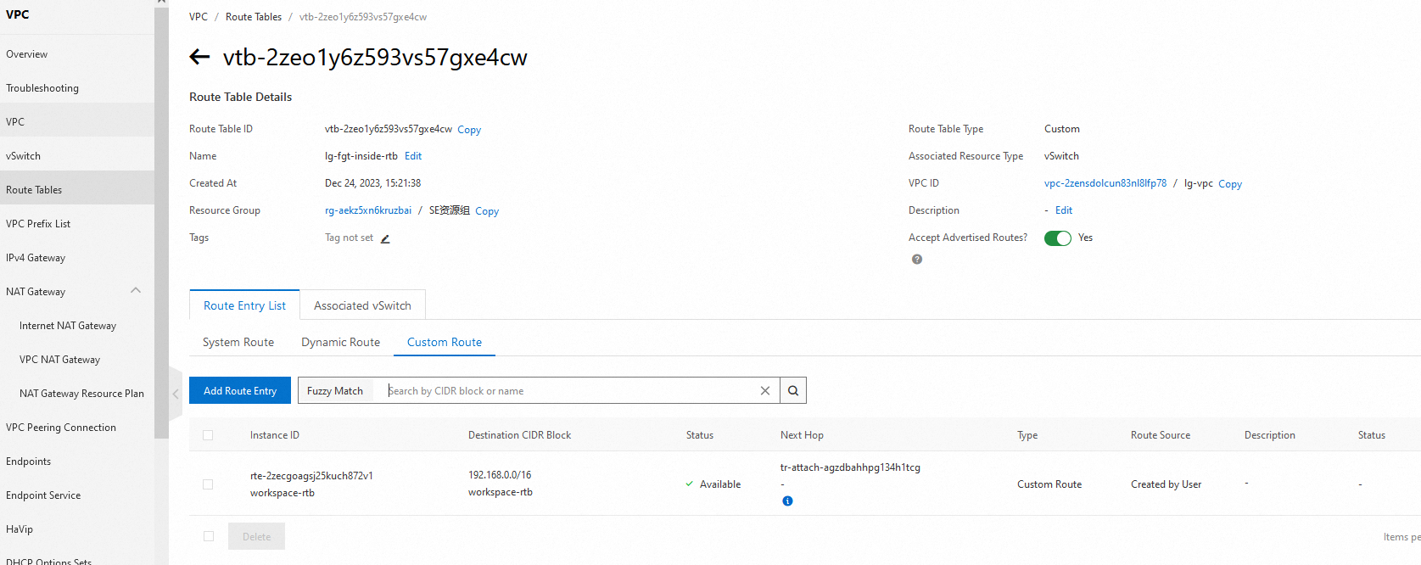
FGT-RTB

Slide 24
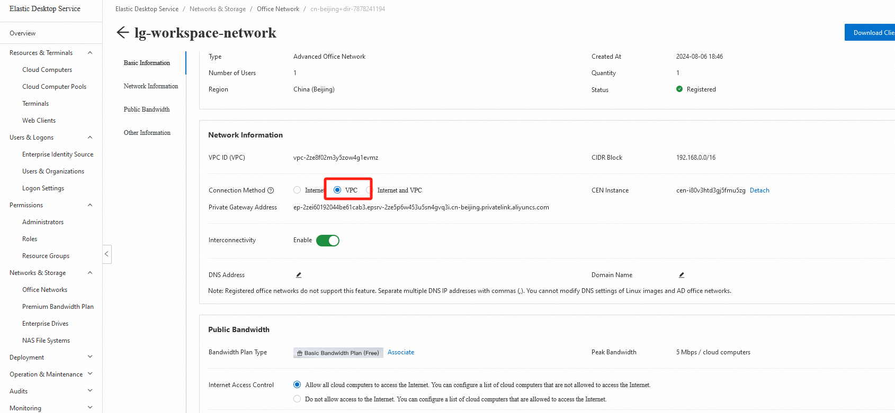
Ali Cloud workspace network setting - vpc

Slide 25
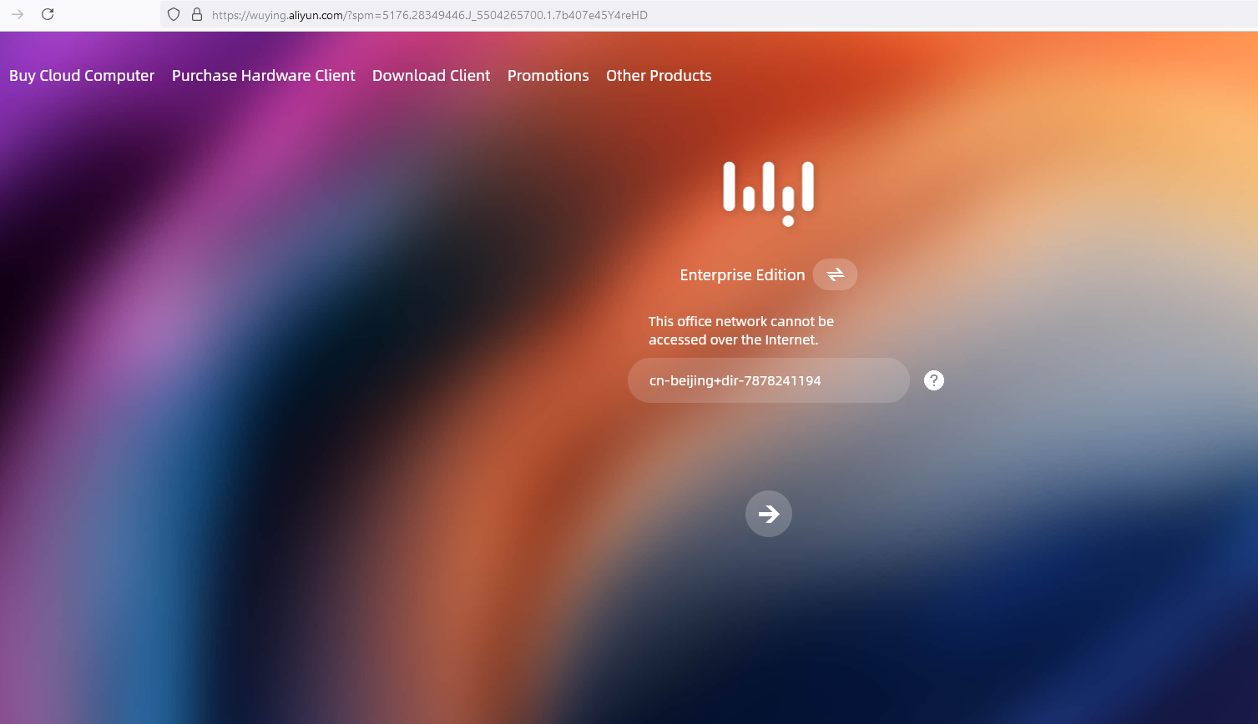
Login error

Slide 26
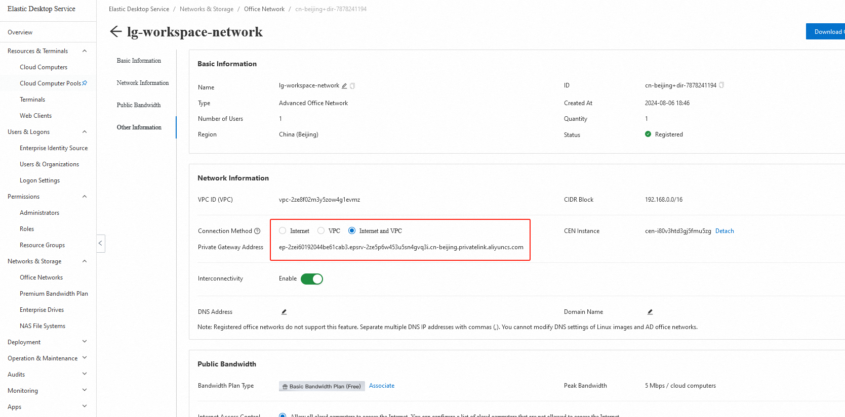
Ali Cloud workspace network setting – vpc and internet

Slide 27
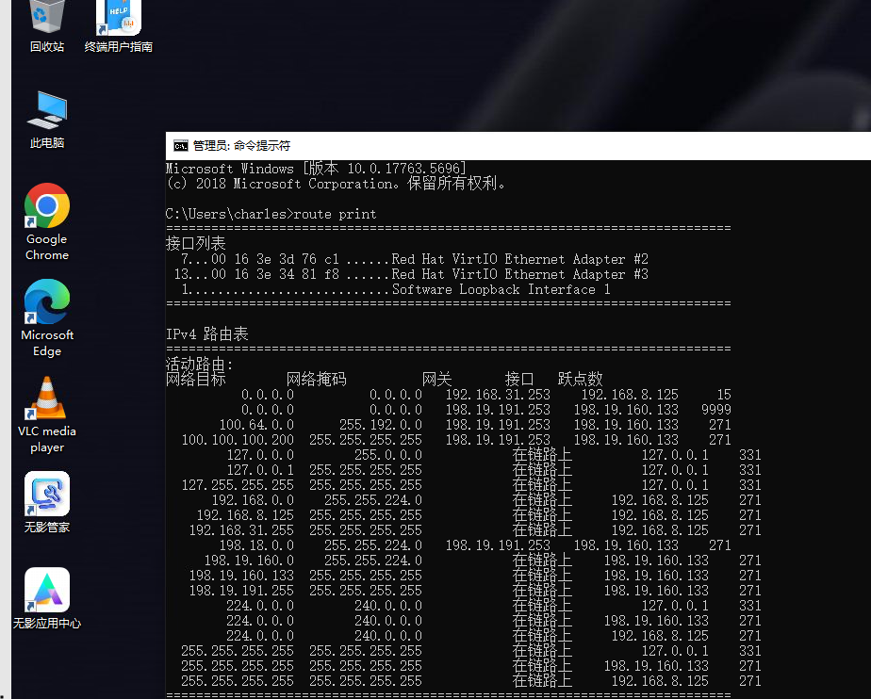
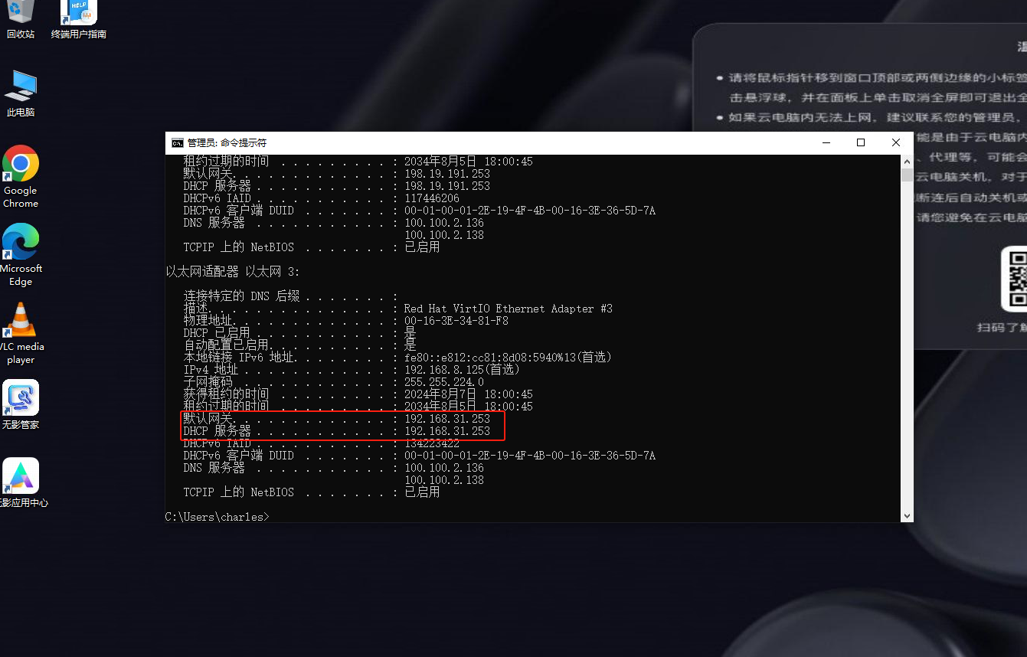
Login success

Slide 28
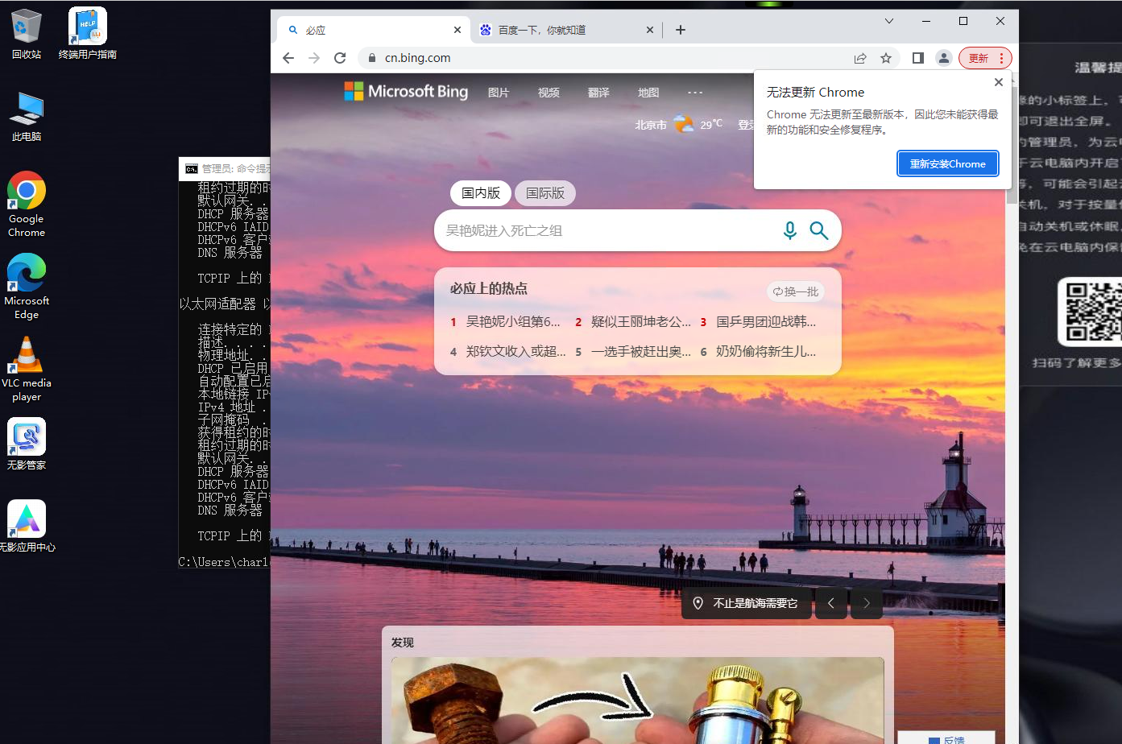
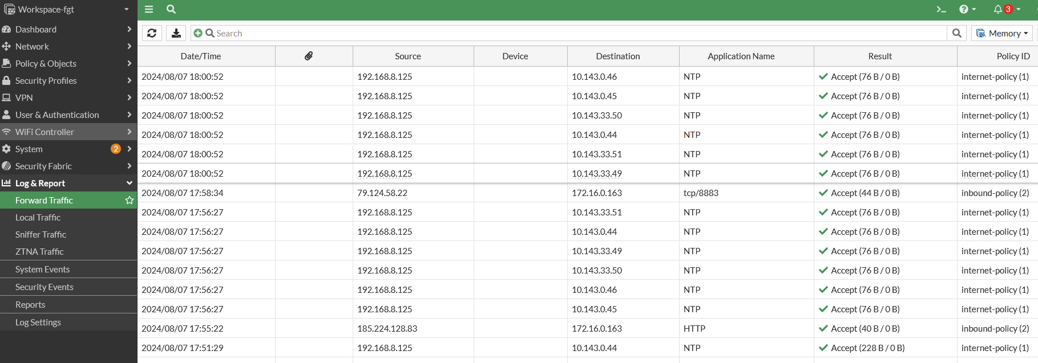
Test-1 log

Slide 29
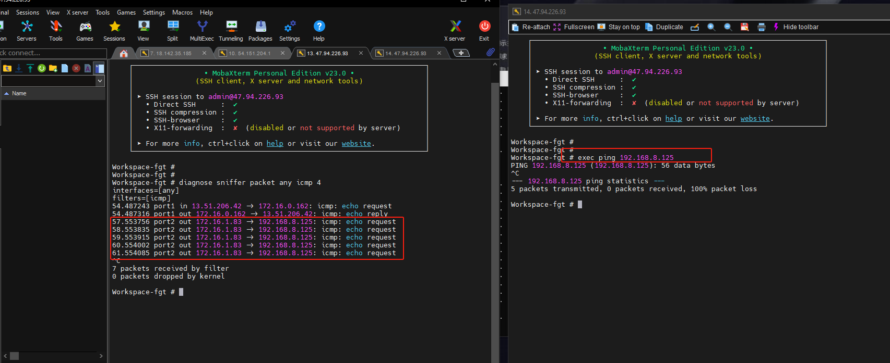
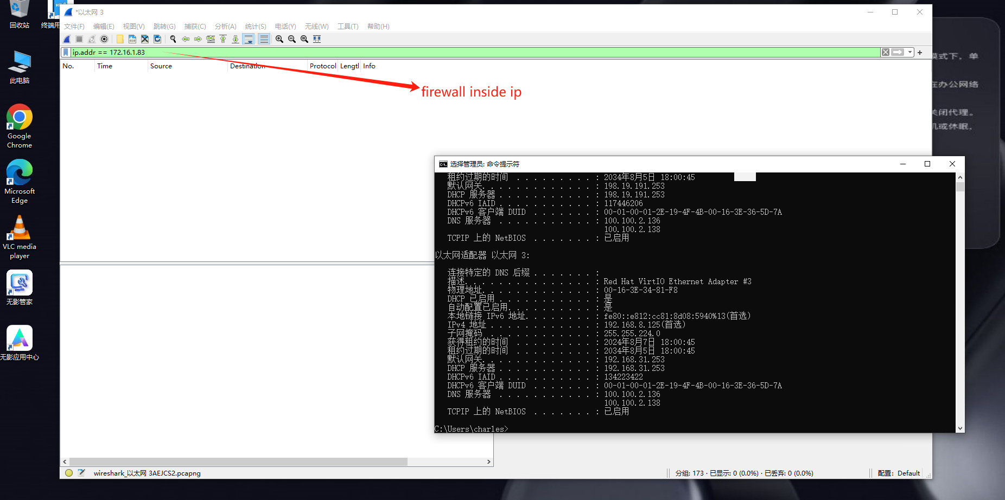
Test-2 log

